Slide 1
Resonate: A Retrieval Augmented Framework For Meeting Insight Extraction
Sartaj Bhuvaji, Prachitee Chouhan, Madhuroopa Irukulla, Jay Singhvi Advisor: Dr. Wan Bae

Slide 2
Motivation
Meetings can be overwhelming, leaving us to remember various details and discussions.
Meetings serve as vital platforms for collaboration and decision making.
It's all too easy to miss a crucial details, if we don't remember meeting details.
Notes:
In the fast-paced professional realm, we attend numerous meetings and serve as vital platforms that exchange large amount of information, discussion about details, challenges, and outcome. Such details can be easily miss and And it is very crucial to remember for effective decision making,

Slide 3
Problem Statement
In today's professional landscape, meetings are a daily occurrence, often filled with valuable discussions and decisions. Recalling crucial details can be challenging, hindering productivity.
Our project aims to develop a chat interface to help users extract pivotal insights from historical meetings, using Retrieval Augmented Generation techniques to enable seamless information retrieval.
By grouping meetings based on abstractive summaries by leveraging clustering algorithms, this will provide users with precise responses and a high-performance solution for content discovery.

Slide 4
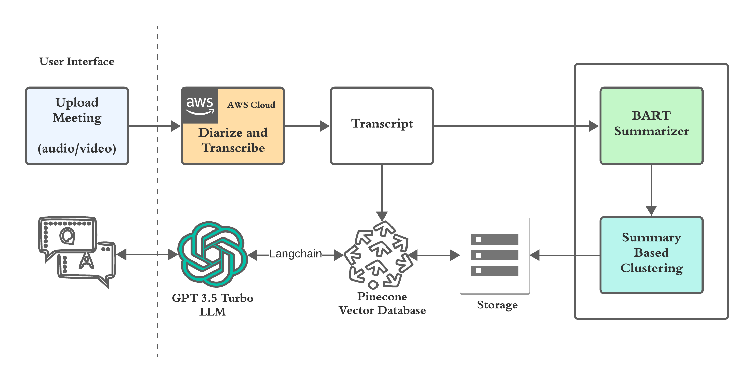
System Framework

Slide 6
Abstractive summarization
Cluster | Meeting Time | Abstractive Summary | Ground Truth
architecture | 28 | This is the second meeting of the group. First, the group discussed the logistics of the new time zone. They discussed how to deal with the different time zones of the time zones. Then, they discussed how they could make their work better by making it easier for people to share their work with the world. Lastly, they talked about how to make the new diffs architecture better for the group and how they would make it easier to share ideas about their work and future work with other groups. This meeting was about the progress of the team's work on the DS project. The team first discussed the technical matters, then moved onto a discussion about how they would make their work more efficient. The final decision was made that the team should focus on the service side rendering, but the team was not sure what they should do to make it better. Finally, the meeting ended with a brief discussion about the future of the project, which was mainly about future work and future thoughts on the project. | The conversation revolves around optimizing meeting times across different time zones. They discuss proposed meeting times and their implications. Suggestions include marketing the meeting better, proposing earlier times, and considering various time zones' constraints. Additionally, they discuss prioritizing performance metrics and trade-offs in software development. They plan to collaborate on documentation and explore ways to improve file highlighting efficiency in the software team members discuss progress and tasks. They cover issues like code migration, documentation, and diagram updates. They prioritize completing tasks efficiently rather than seeking perfection. The discussion revolves around merging requests and clarifying architecture changes. They aim for clarity in tasks and encourage participation in defining completion criteria. Despite some chaos, they resolve issues and plan future meetings to ensure progress.
LLM Model: Facebook BART
Using Fine-tuned version from Hugging Face.
Notes:
Bidirectional Autoregressive Transformer (BART) is a Transformer-based encoder-decoder model, often used for sequence-to-sequence tasks like summarization and neural machine translation. BART is pre-trained in a self-supervised fashion on a large text corpus. During pre-training, the text is corrupted and BART is trained to reconstruct the original text (hence called a "denoising autoencoder"). Some pre-training tasks include token masking, token deletion, sentence permutation (shuffle sentences and train BART to fix the order), etc.

Slide 7
Dataset
23 meetings
Topics : Architecture, Office relocation, Social Media, Device

Slide 8
Summarization Model Evaluation
BERT Score
Meeting | Precision | Recall | F1 | Similarity Score
Architecture | 0.5840 | 0.5869 | 0.5854 | 0.8641
Remote Control | 0.7197 | 0.6982 | 0.7088 | 0.8981
HR | 0.6973 | 0.7240 | 0.7104 | 0.9114
Social Media | 0.7157 | 0.7052 | 0.7104 | 0.9049
Contextual Embeddings
Sentence Ordering
F-score Calculation
8
Notes:
Bidirectional Encoder Representations from Transformers
•Cosine Similarity with BERT Embeddings, measures the similarity between the embedding vectors of the summary and the ground truth. These embeddings capture the semantic meaning of the text. .BERT embeddings are more focused on the overall semantic content of the text, whereas BERTScore considers specific n-gram overlaps.
Contextual Embeddings: BertScore uses contextual embeddings from pre-trained BERT models to capture the semantic similarity between sentences. This allows it to better capture the meaning of words in context, leading to more accurate evaluations.
Sentence Ordering: BertScore considers the ordering of sentences by comparing them in the context of the entire document. This helps in evaluating the coherence and flow of the summary.
F-score Calculation: BertScore calculates an F-score based on precision and recall, similar to Rouge, but uses contextual embeddings for a more nuanced comparison. This makes BertScore more sensitive to semantic similarity and less reliant on exact matches of n-grams.

Slide 9
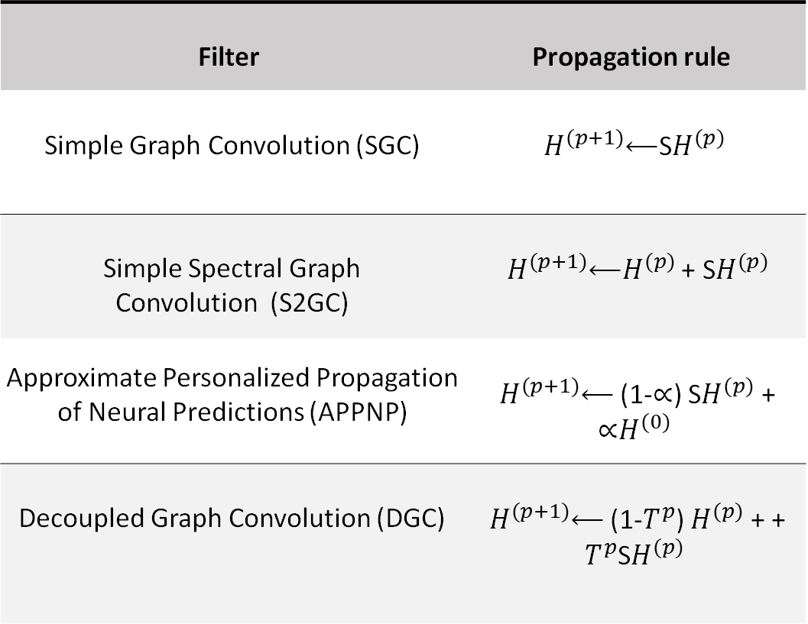
Clustering
Filter | Propagation rule
Simple Graph Convolution (SGC) | $H^{(p+1)}$⟵S$H^{(p)}$
Simple Spectral Graph Convolution (S2GC) | $H^{(p+1)}$⟵$H^{(p)}$ + S$H^{(p)}$
Approximate Personalized Propagation of Neural Predictions (APPNP) | $H^{(p+1)}$⟵ (1-∝) S$H^{(p)}$ + ∝$H^{(0)}$
Decoupled Graph Convolution (DGC) | $H^{(p+1)}$⟵ (1-$T^{p}$) $H^{(p)}$ + + $T^{p}$S$H^{(p)}$
Inspired by paper, titled as “More discriminative sentence embedding via semantic graph smoothing.”
H is the vector, p is the propagation order, ∝ and T are filter-specific hyperparameters.
Notes:
This approach is based on a paper, More discriminative sentence embedding via semantic graph smoothing in this they have used 4 polynomial filters as
Simple Graph Convolution
Simple Spectral Graph Convolution
Approximate Personalized Propagation of Neural Predictions
Decoupled Graph Convolution
SGC (Simple Graph Convolution) is a straightforward approach to graph convolutional networks, focusing on simplicity by multiplying normalized local neighborhood information by vector embedding some specific number of times.
S2GC (Simple Spectral Graph Convolution) employs spectral graph theory to perform convolutions directly in the graph Fourier domain, so it adds the vector to SGC. And this
offers insights into graph structures.
APPNP (Approximate Personalized Propagation of Neural Predictions) leverages personalized propagation to iteratively refine node representations based on their local neighborhood information in the graph. It needs to a hyperparameter alpha. This process helps to smooth out noisy or sparse embeddings and enhance the semantic coherence of the learned representations.
DGC (Decoupled Graph Convolution) enhances the representation learning process by explicitly separating the spatial information (capturing local node relationships) from the spectral information (capturing global graph structure). By decoupling these components, DGC can better capture and disentangle complex patterns in the data, leading to more informative and semantically meaningful embeddings.
And they have used sentencetransfomer as a embedding, kmeans as clustering algorithmns, while in our case we are using these four polynomial filters with mean shift and hdbscan.

Slide 10
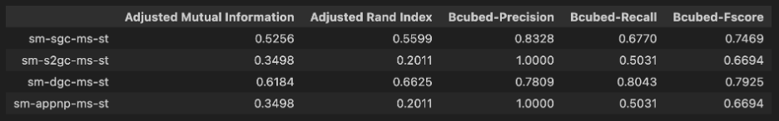
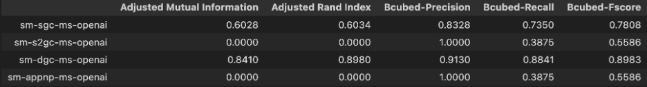
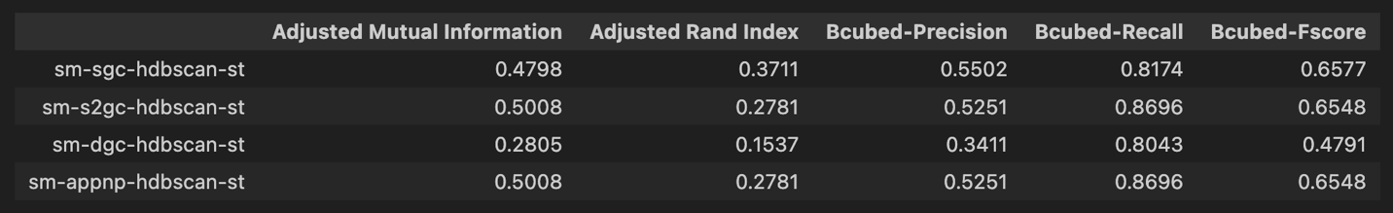
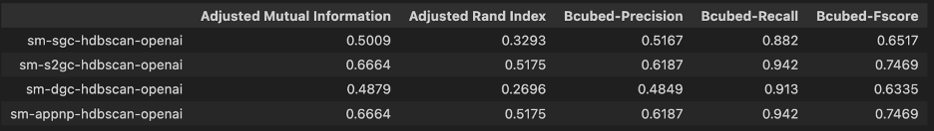
Clustering models Evaluation
Vector Embedding-SentenceTransformer(model=all-mpnet-base-v2)
Vector Embedding-OpenAI (model=text-embedding-3-large)
Mean-Shift
Mean-Shift
HDBSCAN
HDBSCAN
10
Notes:
This slide shows the result of these four polynomial filters on meanshift and hdbscan with SEntenceTransformer on left side and openai on right side primarily using adjusted mutual information and adjusted rand index. When we were using SentenceTransformer, We can see that AMI, ARI and Bcubed Fscore is high for meanshift with dgc polynomial filter.
When we were using openai embedding, and we can see that the mean shift models using s2gc and appnp performed poorly. However, when using meanshift with dgc filter, the performance of the model shows in AMI of 0.84, ARI and Fscore with .89 , which is than other models with both embedding.
Hence, when we are using mean-shift with dgc filter on OpenAI embedding as a clustering algorithm to form clusters of transcript based on abstractive summaries generated in the prior section.

Slide 11
Retrieval-augmented generation(RAG) Modelling Evaluation
Groundedness:
0 to 1
Measure of how well the answer is supported by the context.
Answer Relevance:
0 to 1
Measure of how well the answer is relevant to the question.
Context Relevance:
0 to 1
Measure of how well the context fetched from DB is relevant to the question.
Cosine Similarity
0 to 1
Measures how similar answer by LLM is to the ground truth.
Notes:
Groundedness:
Measures how well the answer generated by the LLM is supported by the context.
Answer Relevance:
Measures how well the answer generated by the LLM is relevant to the question.
Context Relevance:
It measure the performance of the vector store, by telling us how relevant the context is to the question.
Cosine Similarity: This is a measure of how similar the answer provided by the LLM is similar to the ground truth answer.

Slide 12
Example:
No | User Input | Response | Groundedness | Context Relevance | Answer Relevance | Cosine Similarity
1 | Who recommends universal masking? | The American Academy of Pediatrics and CDC recommends universal masking. | 1 | 0.9 | 1 | 1
2 | How many patients are in the ICU Unit? | There are 23 patients in the ICU Unit located at the East Wing. | 1 | 0.7 | 1 | 0.96
3 | What is the capital of France? | Paris is the capital of France. | 0 | 0 | 1 | 0
* Questions asked for meeting involved COVID-19 Discussion
* LLM : Chat GPT 3.5-Turbo
* Database: Pinecone Serverless
Notes:
Let’s understand the metrics with an example.
Here we upload a meeting where the members of a hospital discussed regarding COVID-19.
We can see the first 2 questions were answered pretty well and have high scores.
However the third question says “What’s the capital of France?”, and we know that no where in the meeting the members talk about France. However LLM comes up with an answer. Ideally we call this as LLM hallucination and we try to avoid such scenarios. And for our project we tackled this issue through Prompt engineering.

Slide 13
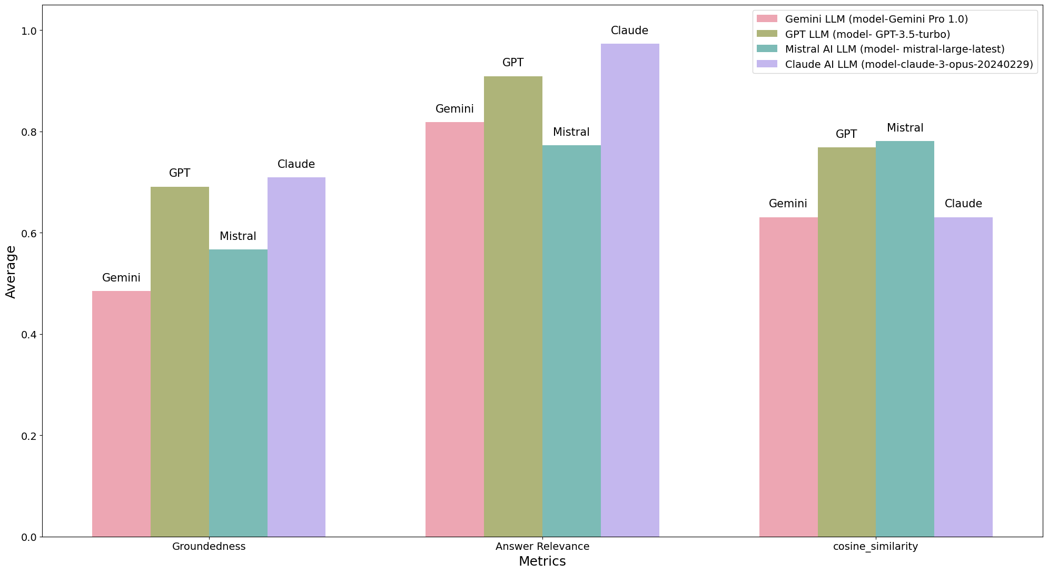
Comparing LLM Models
Calculated over
five questions for each of the
twenty-three meetings.
Notes:
We further compared 4 popular LLM models over the 3 LLM metric.
We see relatively lower groundedness values. This is because LLM models are trained to generate fluent and coherent text, which may sometimes come at the expense of strict adherence to factual grounding.
We also tested with the latest release Claude Opus model and observer highest answer relevance scores. This can be due to higher number of parameters in model.
For cosine similarity, we see decent values ranging from 0.6 to 0.8. Where a higher number means answer was same as ground truth. As cosine similarity is very sensitive to the sequence of words, sometimes LLM results while answering the question correctly may comprise of different words, leading to different score.

Slide 14
DEMO

Slide 15
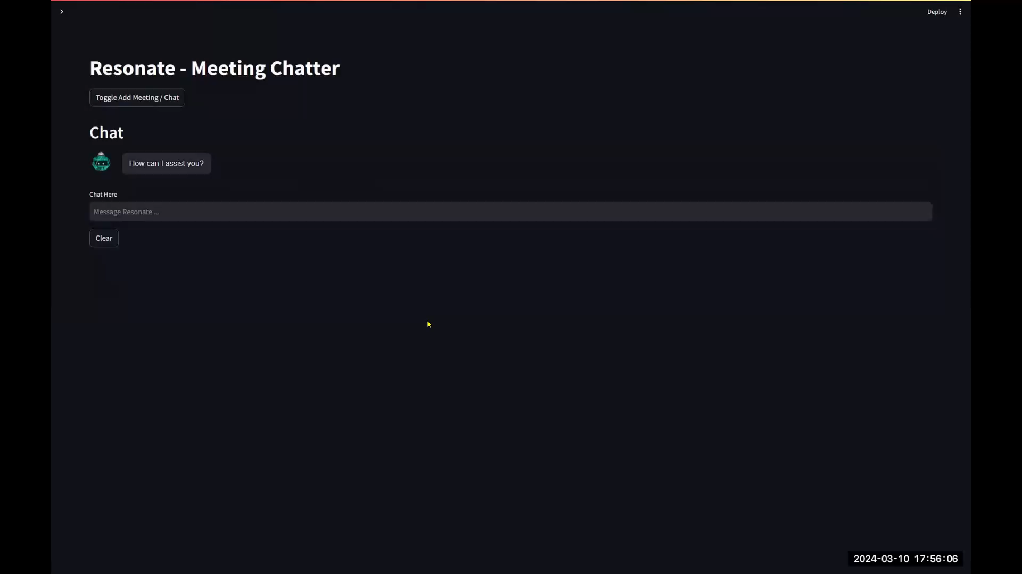

Slide 16
Future Work
Fine Tuning using QLORA.
Researching faster Transcribe model
Exploring different embedding models
Exploring Open Source LLM Models.
Video Frame Tagging
* QLORA: Quantization Low-Rank Adaptation of Large Language Models

Slide 17
Project Learning Outcomes
We learned how Retrieval Augmented Generation architecture works.
We explored different metrics for abstractive summarization.
Different dimensions of vector embedding by offer varying levels of granularity and specificity in representing data and how it effects clustering.
We experimented with LLM architecture and how it manages memory.

Slide 18
Thank You

